Slide 1





Quantifying the Efficacy of Wastewater Alkalinity Enhancement on mCDR and
Acidification Mitigation in a Large Estuary
Jeremy Testa, Casey Hodgkins: UMCES Chesapeake Biological Laboratory
Wei-Jun Cai, Zhendong Ji: University of Delaware
Ming Li, Yuren Chen: UMCES Horn Point Laboratory
Sarah Van Pelt, Robert Izett, Will Burt: Planetary Technologies, Inc.
Charles Bott, Alexandria Gagnon, Riley Doyle: HSRD
Special Thanks: Amanda Moore, Najid Hussain, Zhentao Sun, Omar Sadoon, Alex Whitworth, Greg Rau, Dhruv Mehta, Kat Yetka, Scott Fentress, Daniel Christian, Ian Geeson, Bruce Weckworth,

Slide 2
Why this project?
There is wide consensus that negative emissions technologies are required in order to meet global warming mitigation goals
marine Carbon Dioxide Removal (mCDR) is being explored as one mode of negative emissions, where manipulations of marine water lead to uptake and long-term sequestration of carbon in the ocean
Despite a rapid movement to build an industry around mCDR, the efficacy and uncertainty associated with mCDR approaches is poorly understood
There is a need to verify the diversity of proposed mCDR ideas

Slide 3
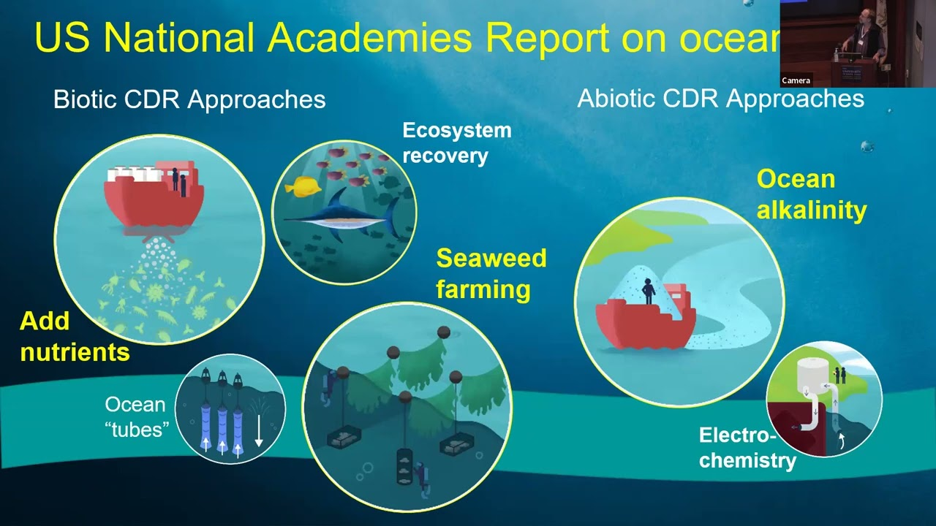
OAE = Ocean Alkalinity Enhancement

Slide 4
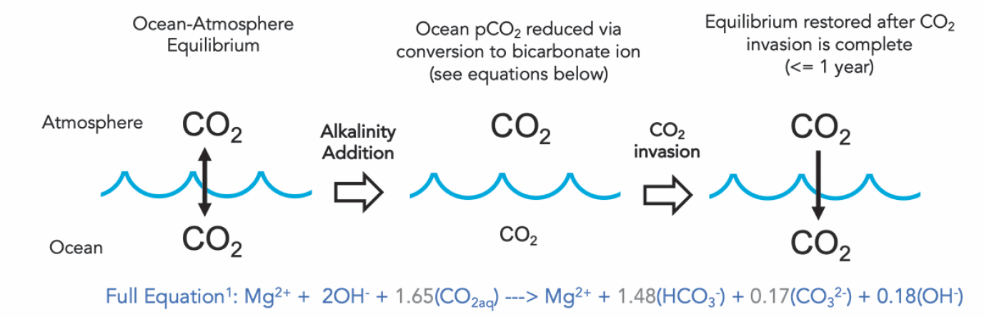
The Basics of the Approach

Slide 5
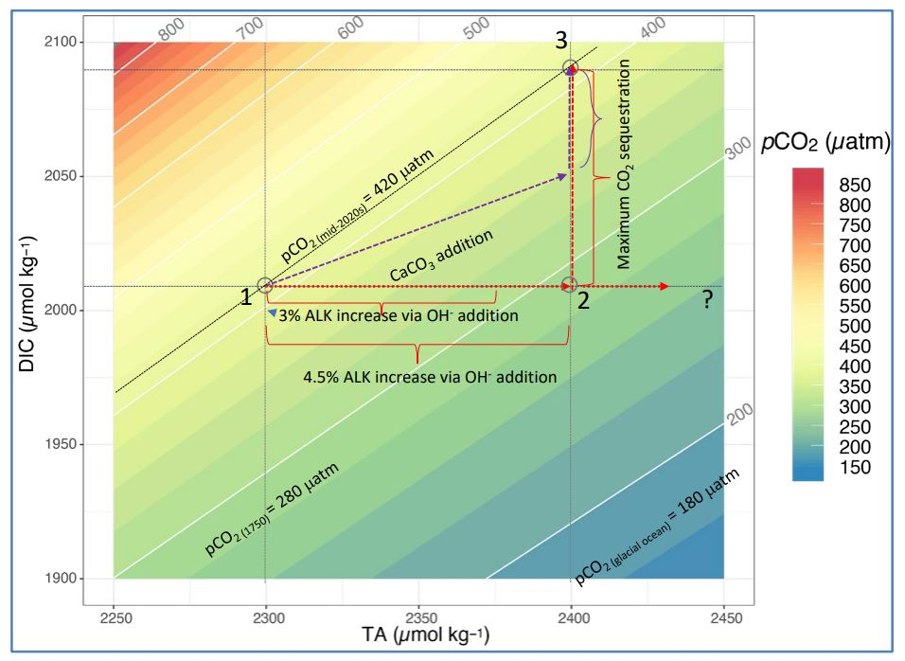
Lime Slurry Ca(OH)₂
CO_{2aq} + OH⁻ → HCO₃⁻
HCO₃⁻ + OH⁻ → CO₃²⁻ + H₂O
A conceptual model of Ocean Alkalinity Enhancement (OAE) approaches within DIC-TA-pCO₂ space

Slide 6
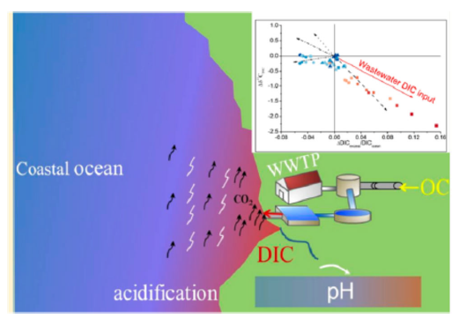
Wastewater treatment for carbon capture
1000 km³ of wastewater generated globally: 300 km³ discharged as
municipal wastewater and over 600 km³ as industrial wastewater.
Sewage has high DIC (3000-5000 mmol C/kg) and high pCO₂ (>10,000 ppm), an important source of coastal acidification (Yang et al. 2018).
Wastewater plants account for 1.6% of greenhouse gas emissions (GHG)
  *0.77 Gt CO2 eq. (Lu et al. 2018).

Slide 7
Benefits of WWTP as a Vehicle for OAE
Supports existing plant process (nutrient removal) while elevating alkalinity/mCDR
(2) No new permits needed
(3) Low pH in WWTP allows for rapid dissolution, limited precipitation
(4) Low-cost delivery (contrast with transporting material to open ocean)
(5) If alkalinity added upstream, reduced CO₂ emission (although ocean uptake will be
limited)
(6) Potential to reduce acidity of discharged wastewater

Slide 8
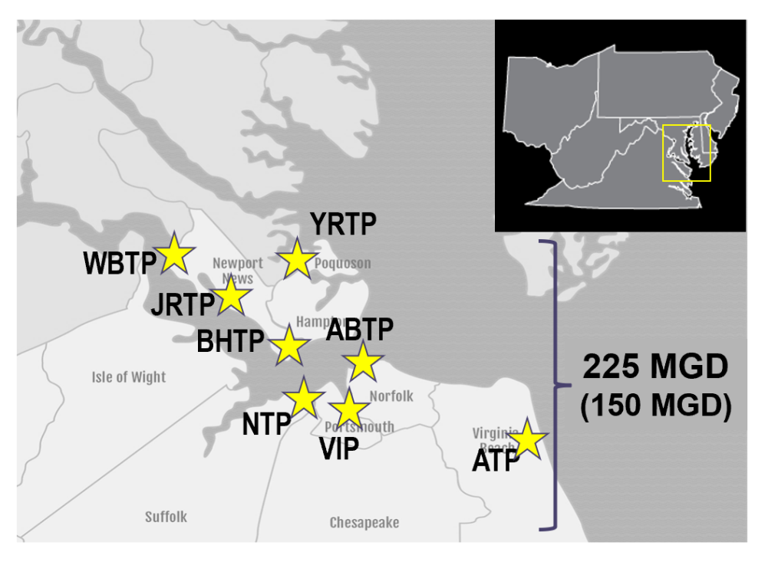
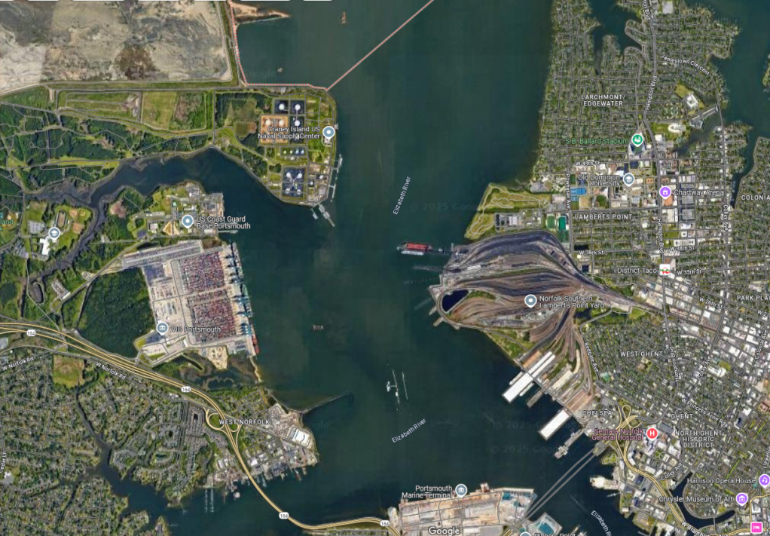
Project Overview
Hampton Roads
Sanitation District Facilities
Ca(OH)₂

Slide 9
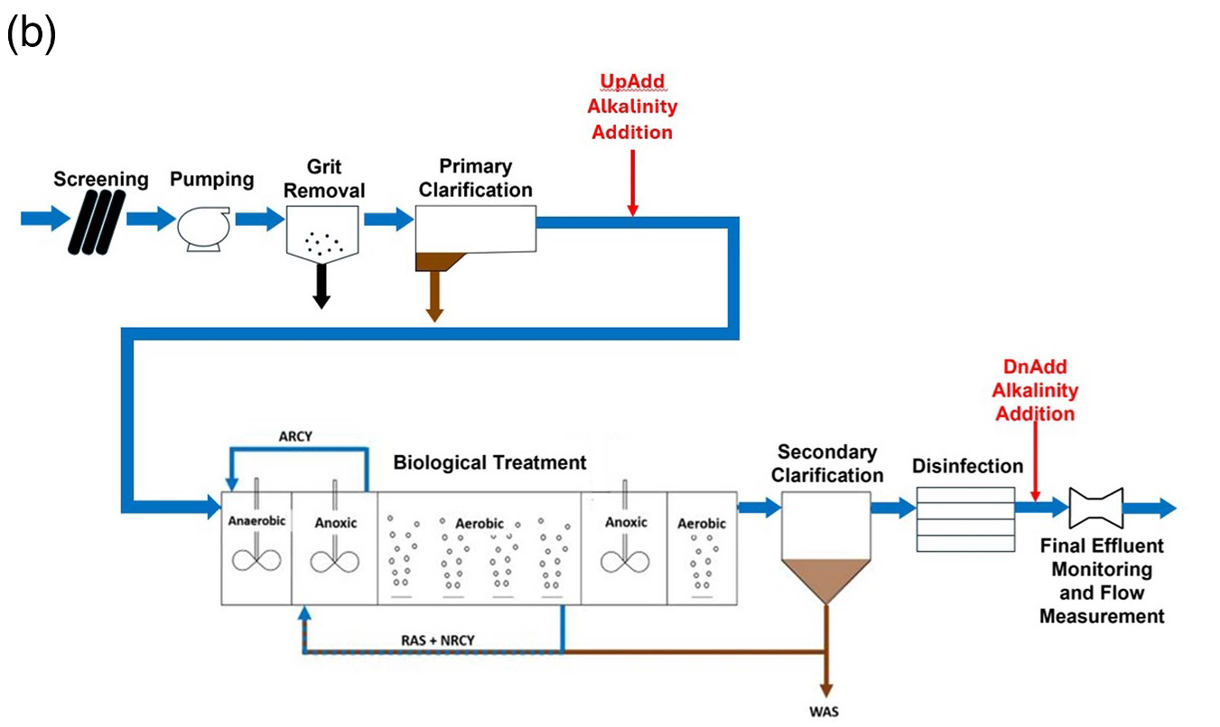
Two Approaches
Process Diagram at VIP
(for
emissions
Reduction)
(for
mCDR)

Slide 10

“Upstream” versus “Downstream”
High CO₂ and CO₂ Emissions
Lower alkalinity
No treatment benefit
Add
Alkalinity
CO₂
High alkalinity,
Low CO₂
Add
Alkalinity
Low CO₂ and CO₂ Emissions
higher alkalinity
treatment benefit
CO₂
Lower alkalinity, high DIC

Slide 11
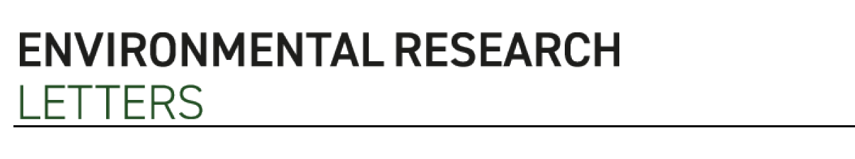
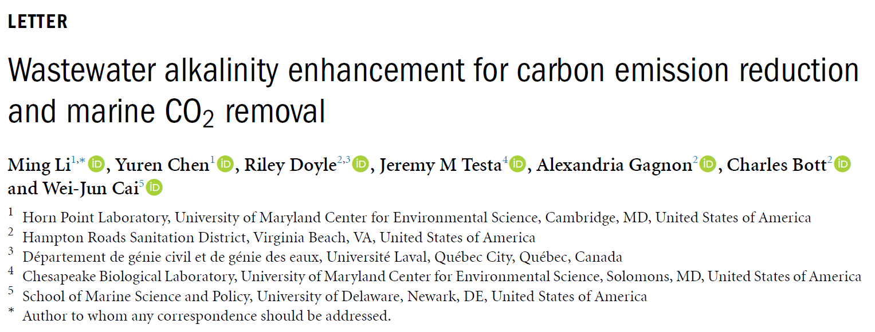
Estuarine Hydrodynamic-Biogeochemical Model
Estimate
emissions reduction
SUMO Model for WWTP Process
Discharge
DIC, TA, pH
Estimate mCDR

Slide 12
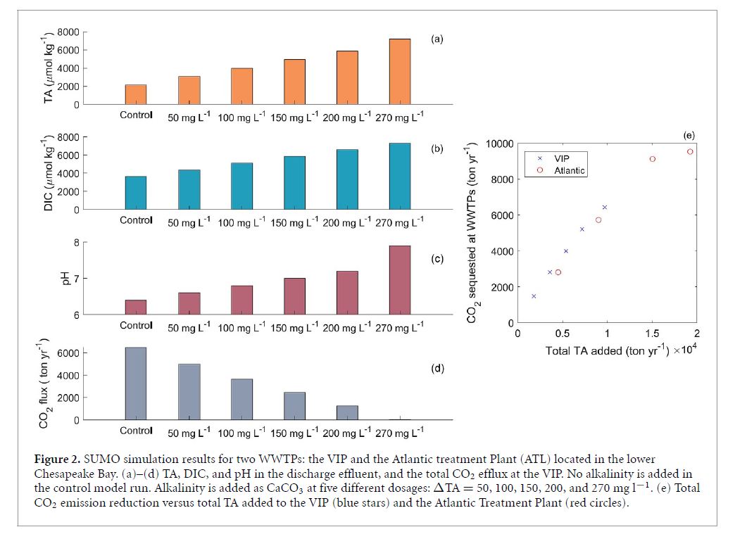
SUMO Simulations of Alkalinity Addition

Slide 13
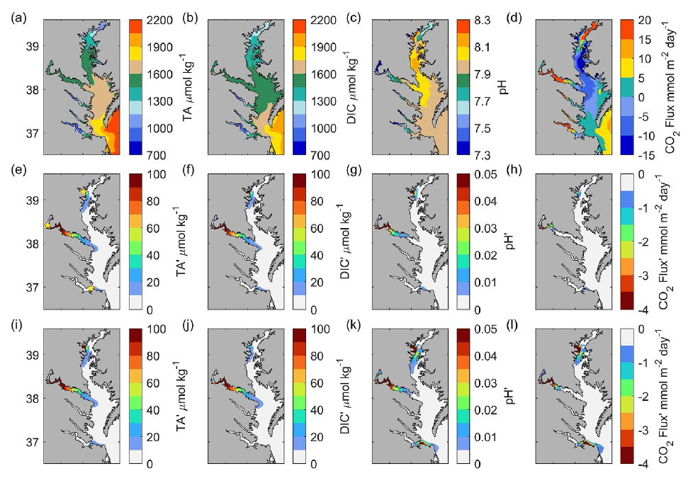
Estuarine Simulations of Alkalinity Addition
UpAdd
DownAdd

Slide 14
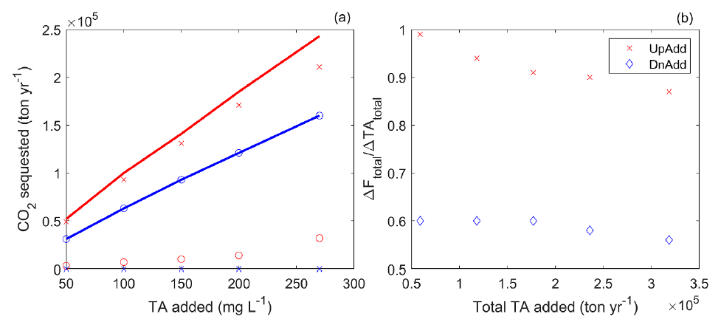

Synthesis: Differential Impact of Alkalinity Addition on CO₂
UpAdd Emission Reduction
Higher total sequestration for UpAdd
DnAdd Ocean Uptake
Low F_{ocean} for upstream
Total carbon sequestration
=
Total TA Added

Slide 15
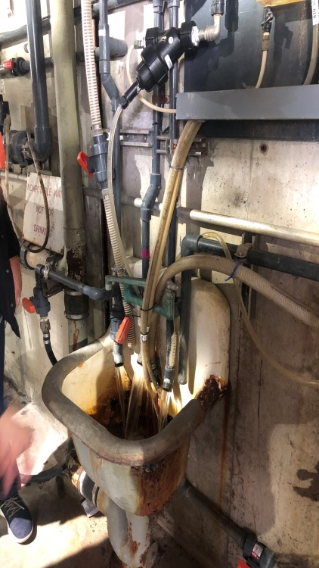
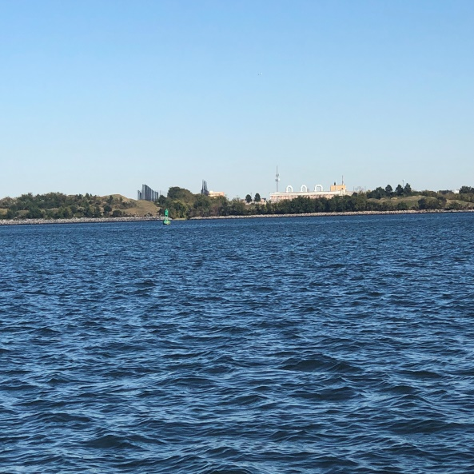
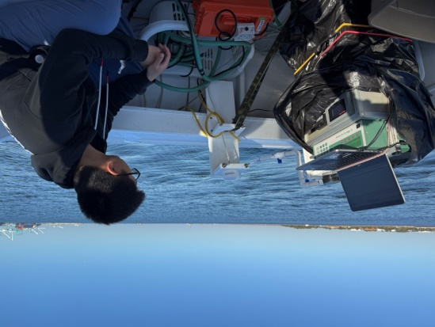
Field Trials: 2024 and 2025
VIP Effluent Sampling
Two Experiments/Field Trials:
Add alkalinity for 1 week in Oct-Nov 2024:
                *Assess effluent pH/alkalinity response to planned injections
                *Measure estuarine response, CO₂ uptake
                *Identify issues, refine sampling plan
(2) Add alkalinity for 4-6 weeks in summer 2025:
  *Longer-term field trial to simulate real application of technology
  *Measure estuarine response, CO₂ uptake, oyster tissue
  *Approach operational process for alkalinity addition
Elizabeth River with
VIP in background
Notes:
Year 1: Work with Planetary and HRSD to plan alkalinity experimental timing and the chosen wastewater facility.
Year 1: Execute the first alkalinity experiment at the chosen wastewater facility and execute the receiving water MRV and the biological sampling.
Year 1: Perform experimental modeling to test a range of alkalinity additions in the vicinity of the chosen wastewater facility, including the experimental base addition.
Year 1: Review and synthesize the modeling and experimental results and plan the year 2 experiments.

Slide 16
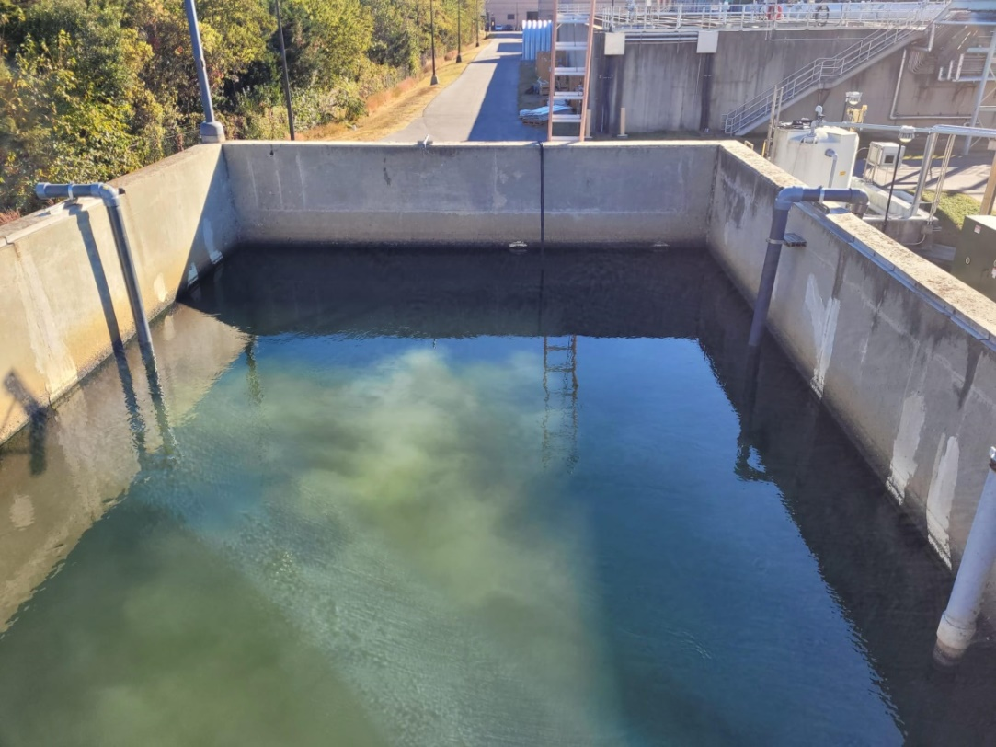
Fall 2024 Trial at VIP
Timeline: Oct 28 – Nov 2, 2024
Downstream Addition: Oct 28 – Oct 30, 2024
Upstream Addition: Oct 31 – Nov 2, 2024
Total Lime Slurry Usage: ~ 4800 gallon
Dosage Rate (downstream)
35-60 gallons/hour
8 hours a day
Dosage Rate (upstream)
80-200 gallons/hour
24 hours a day

Slide 17
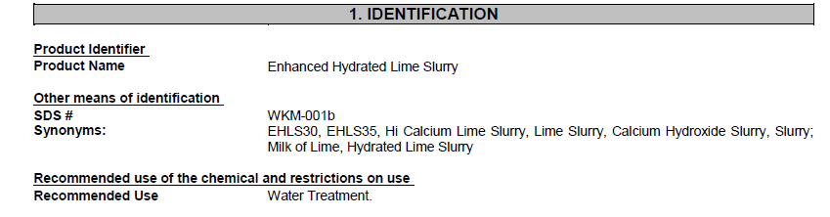
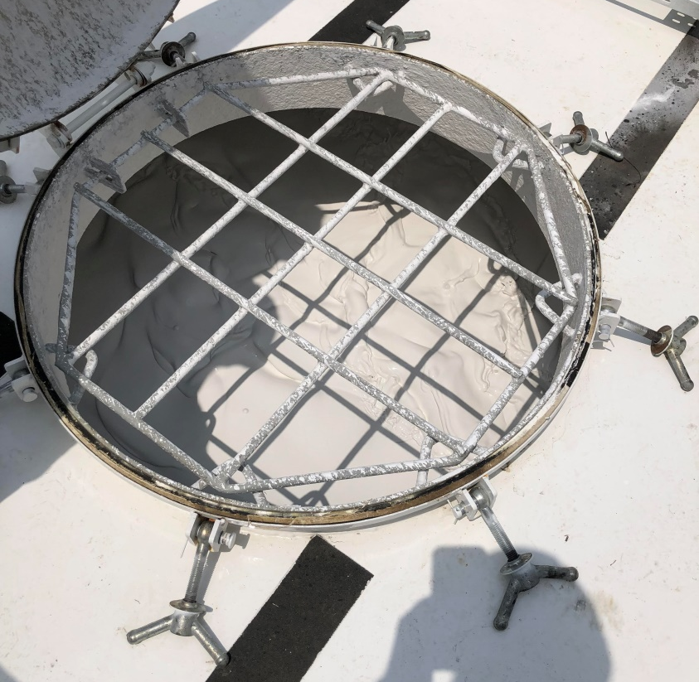
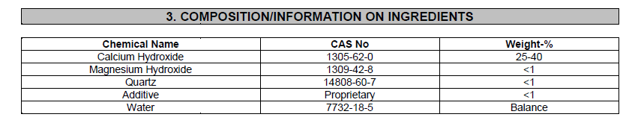
In Trial 1, we used and “off-the-shelf”
Alkalinity source

Slide 18
Pre-Experiment Laboratory Testing
Quicklime
MgO
Mg(OH)₂
Closed-system experiment with VIP effluent
3 different sources of alkalinity

Slide 19
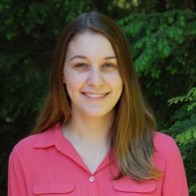
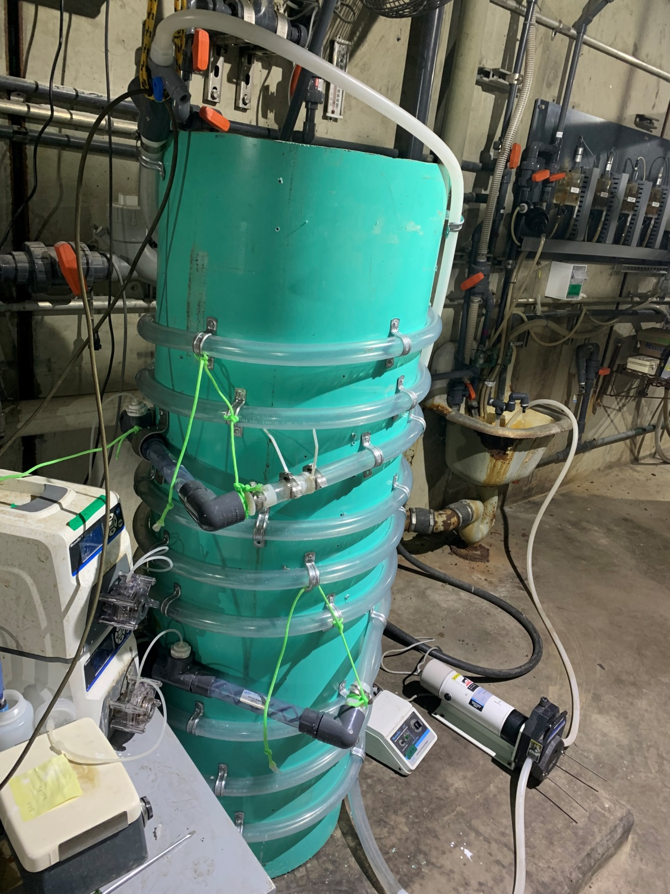
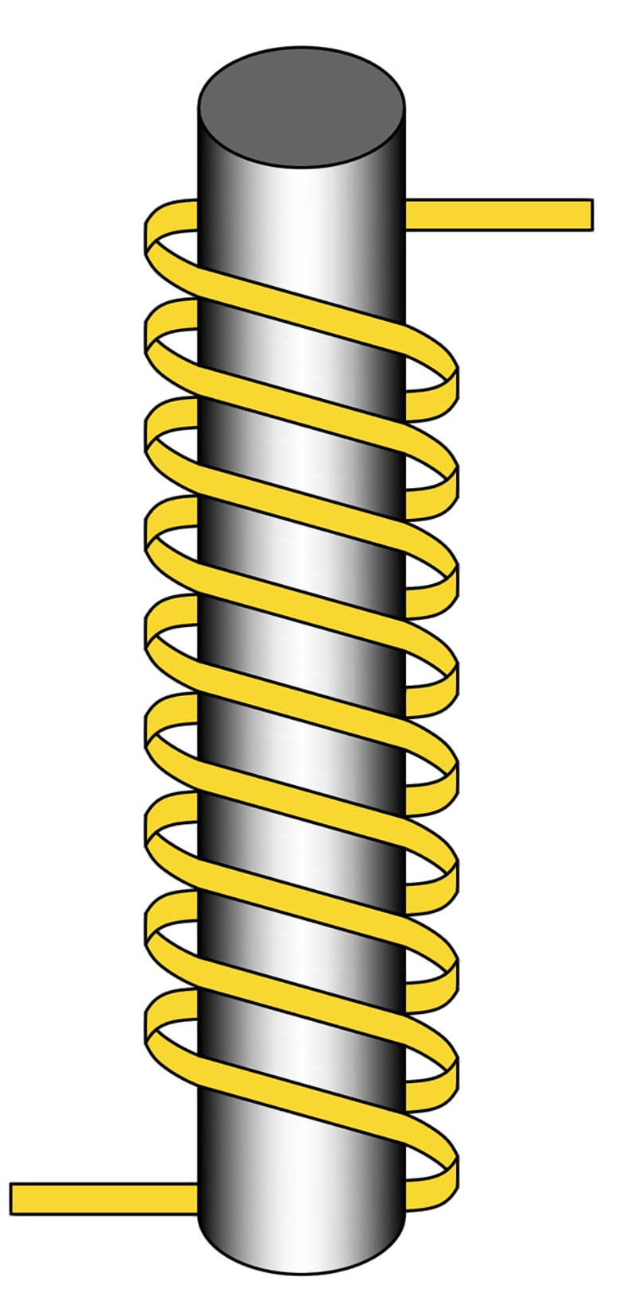
Pre-Experiment: Flow Reactor Design
Lime Addition
Bisulfite Addition
1
2
3
4
5
20.7 ft
20.7 ft
16.7 ft
Influent
pH probe
Effluent
4
5
3
Influent Flow Rate: 4.3 L/min with 1’’ tube
Distance | Design HRT (seconds)
Influent to Lime Addition | 45
Lime Addition to Bisulfite Addition | 45
Bisulfite Addition to Effluent | 36.4
Total | 126.4
2
1
1’’ tubing wrapped around PVC Pipe with static mixers after addition points
*Influent = 30-minute contact tank sample point

Slide 20
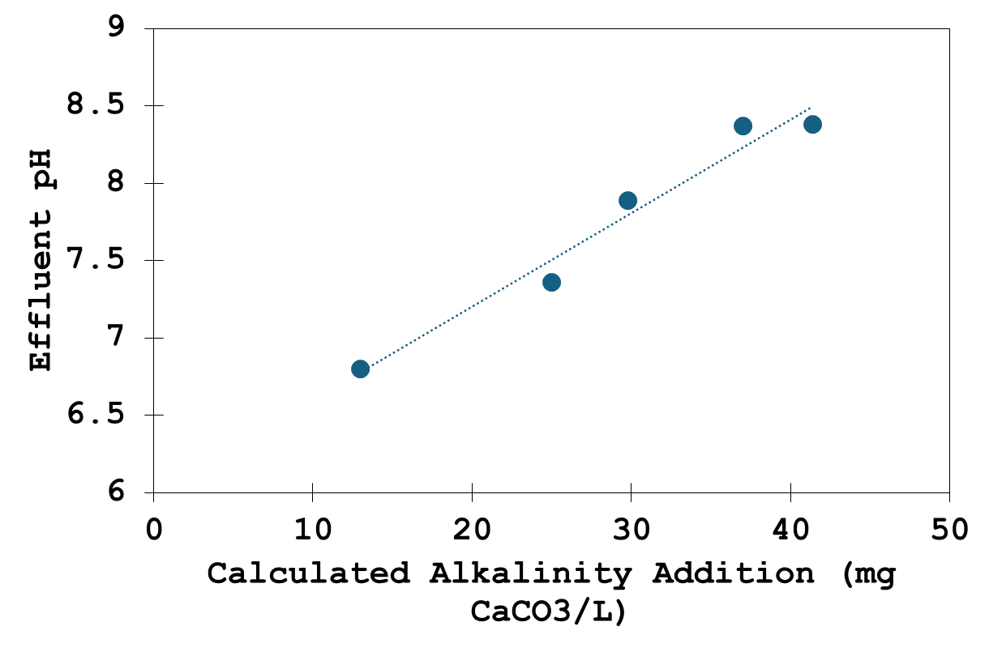

Slide 21
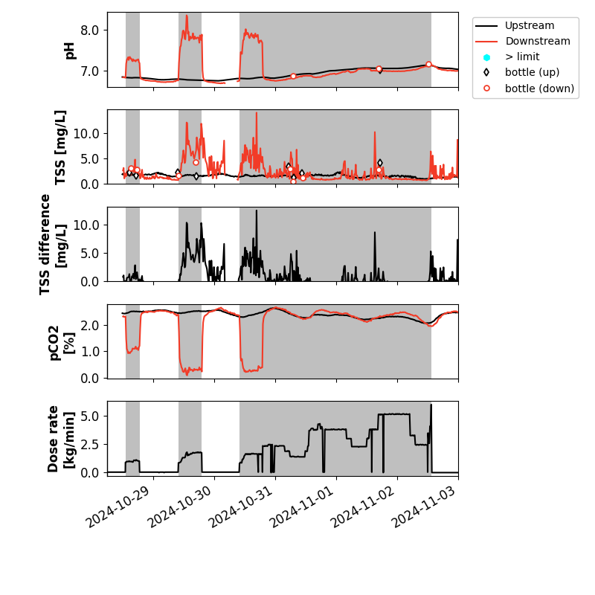
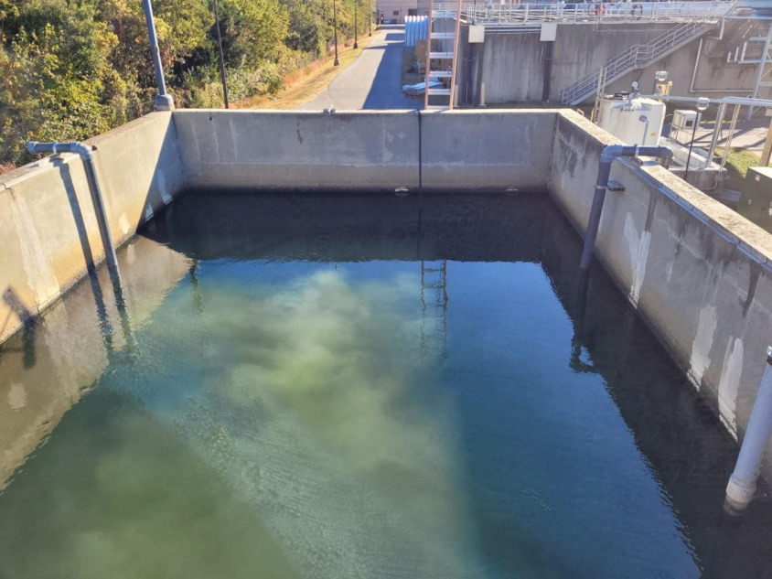
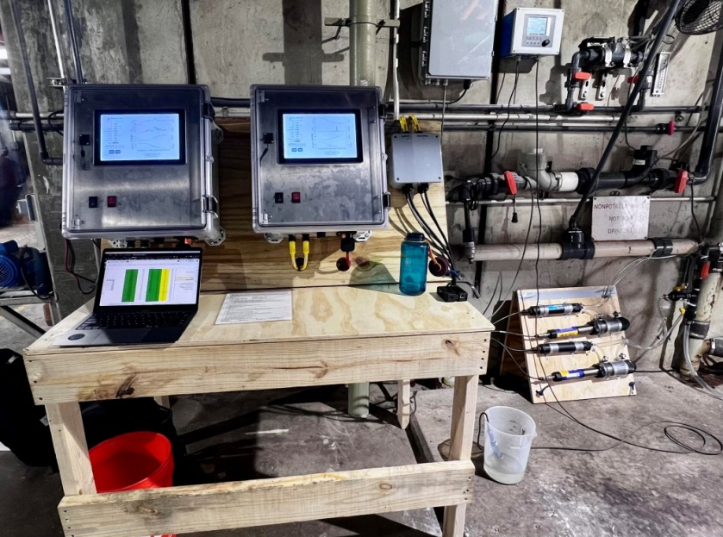

Slide 22
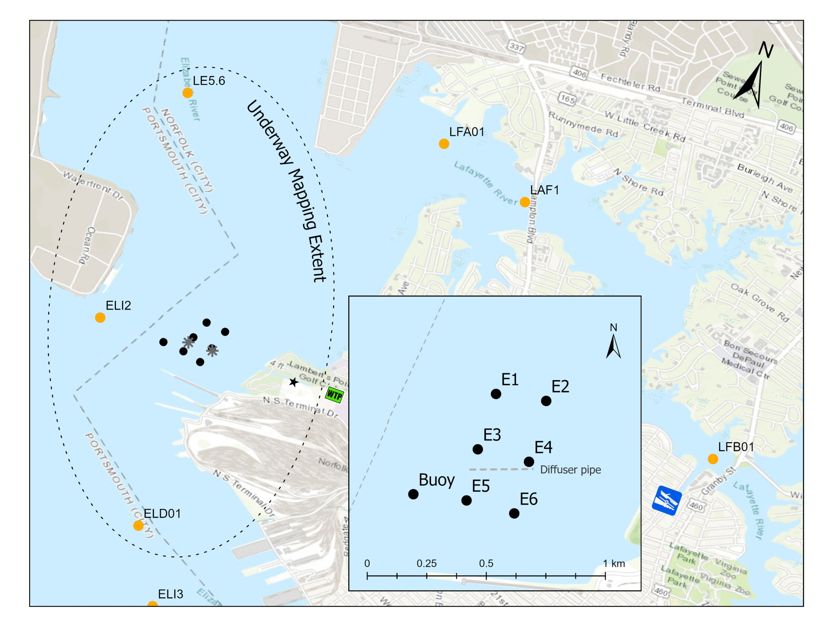

Slide 23

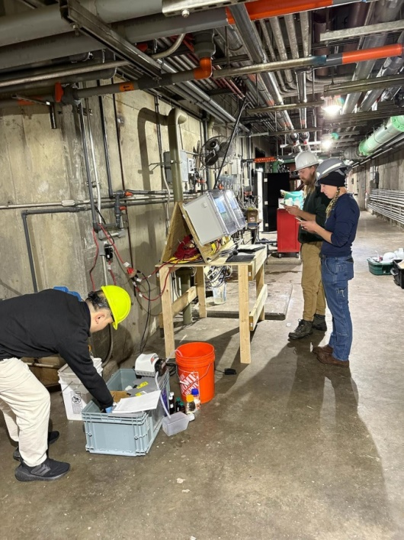

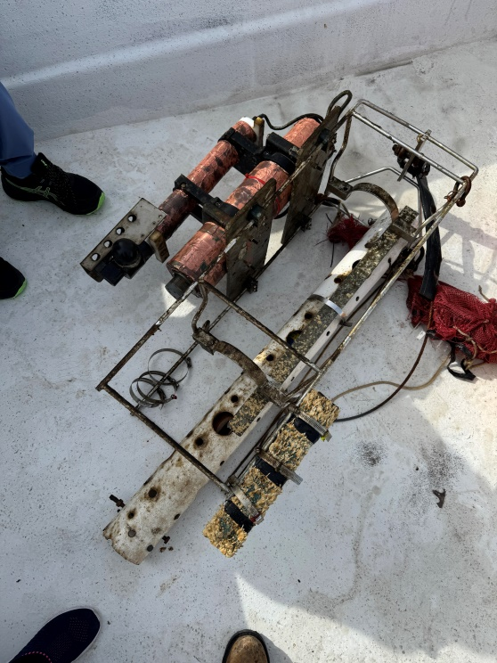
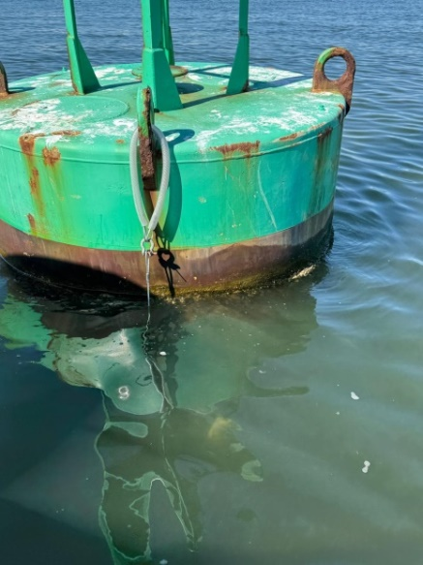
Measurement, Reporting, and Verification (MRV)
Estuary
pCO₂: Underway pCO₂ system
Discrete DIC, TA, pH (high and low tide)
Real-time CTD, oxygen, turbidity, fluoresence
Discrete Chl-a, TSS, nutrients, metals
WWTP Outfall
Discrete DIC, TA, pH, pCO₂ (hourly-daily-weekly)
Real-time pH, pCO₂, turbidity
Discrete pH, metals

Slide 24
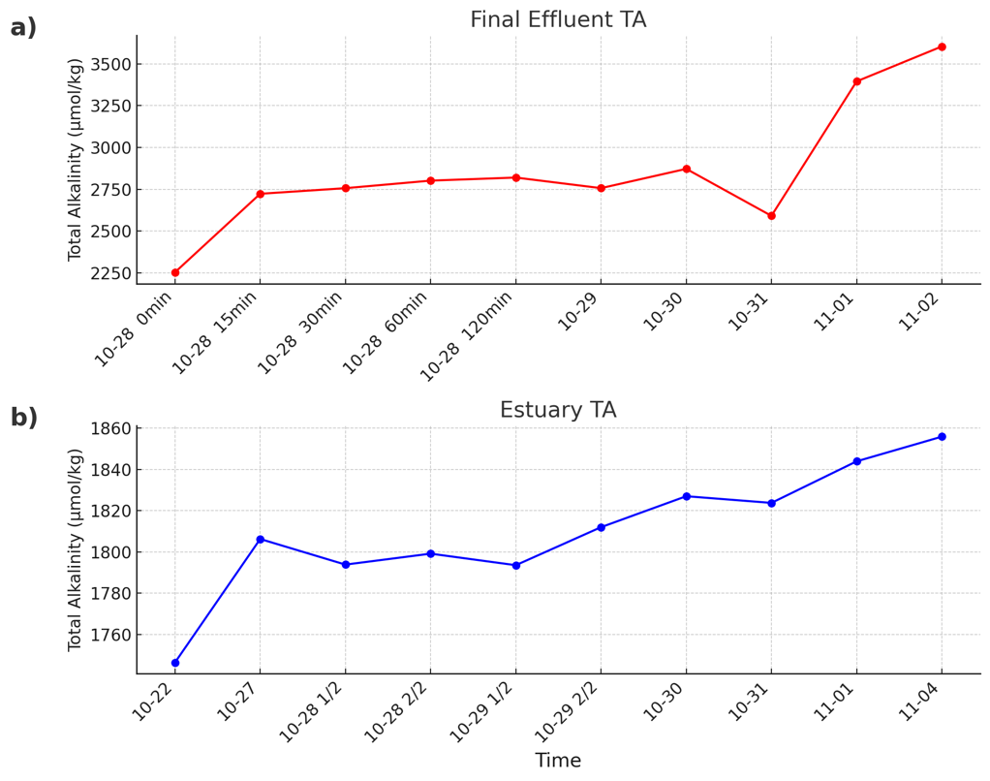
Fall 2024 Trial Effluent and Estuary TA

Slide 25

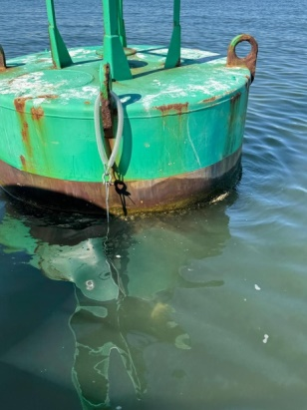
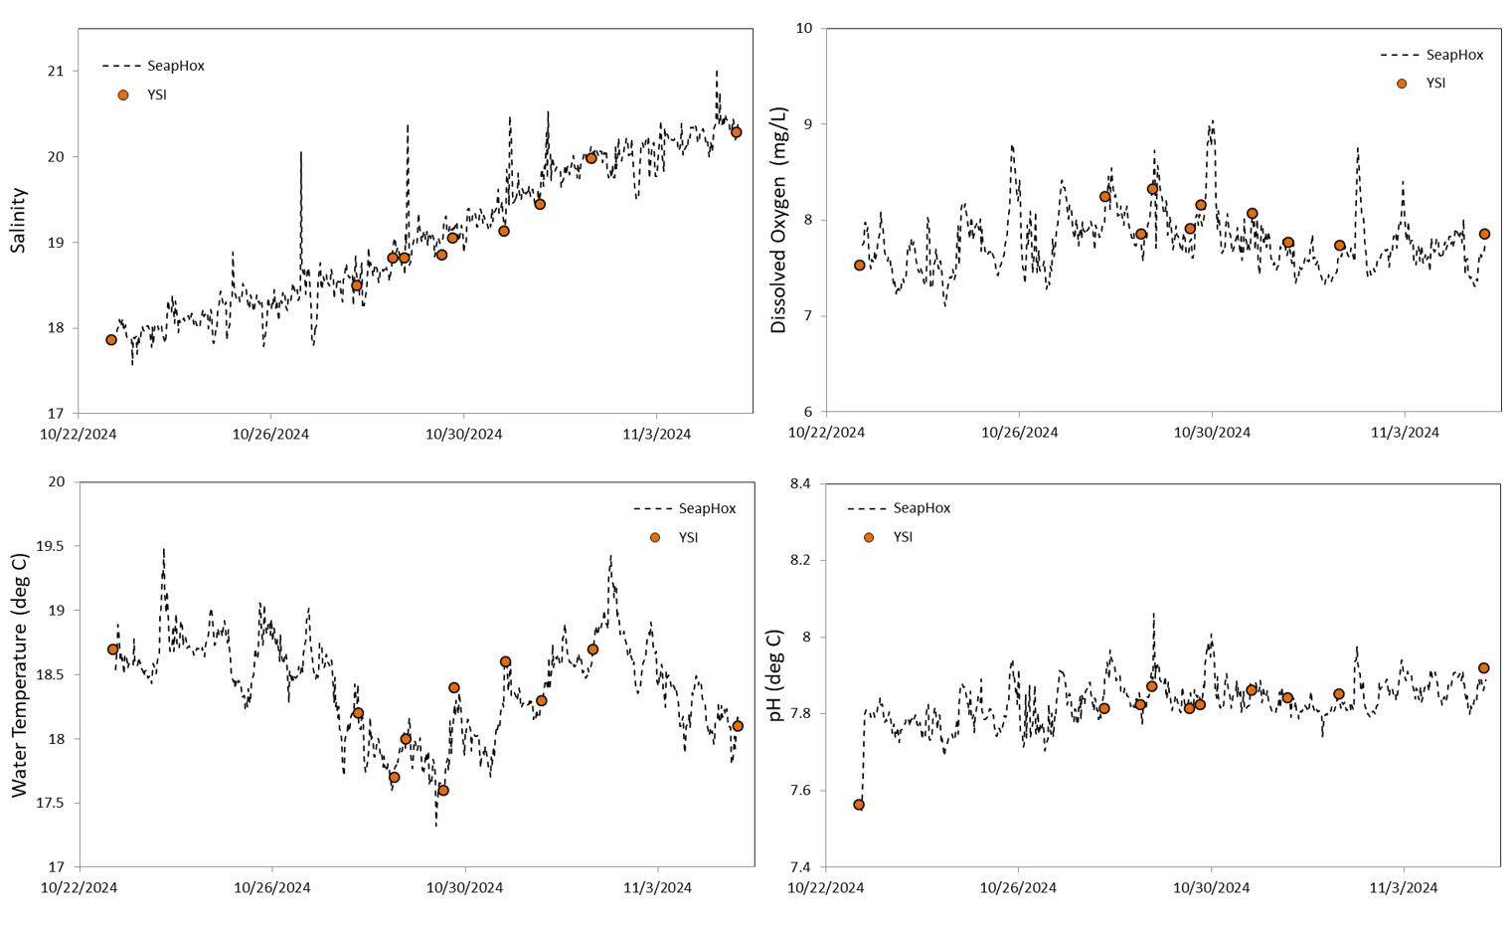
Fall 2024 Trial
Estuary Conditions

Slide 26
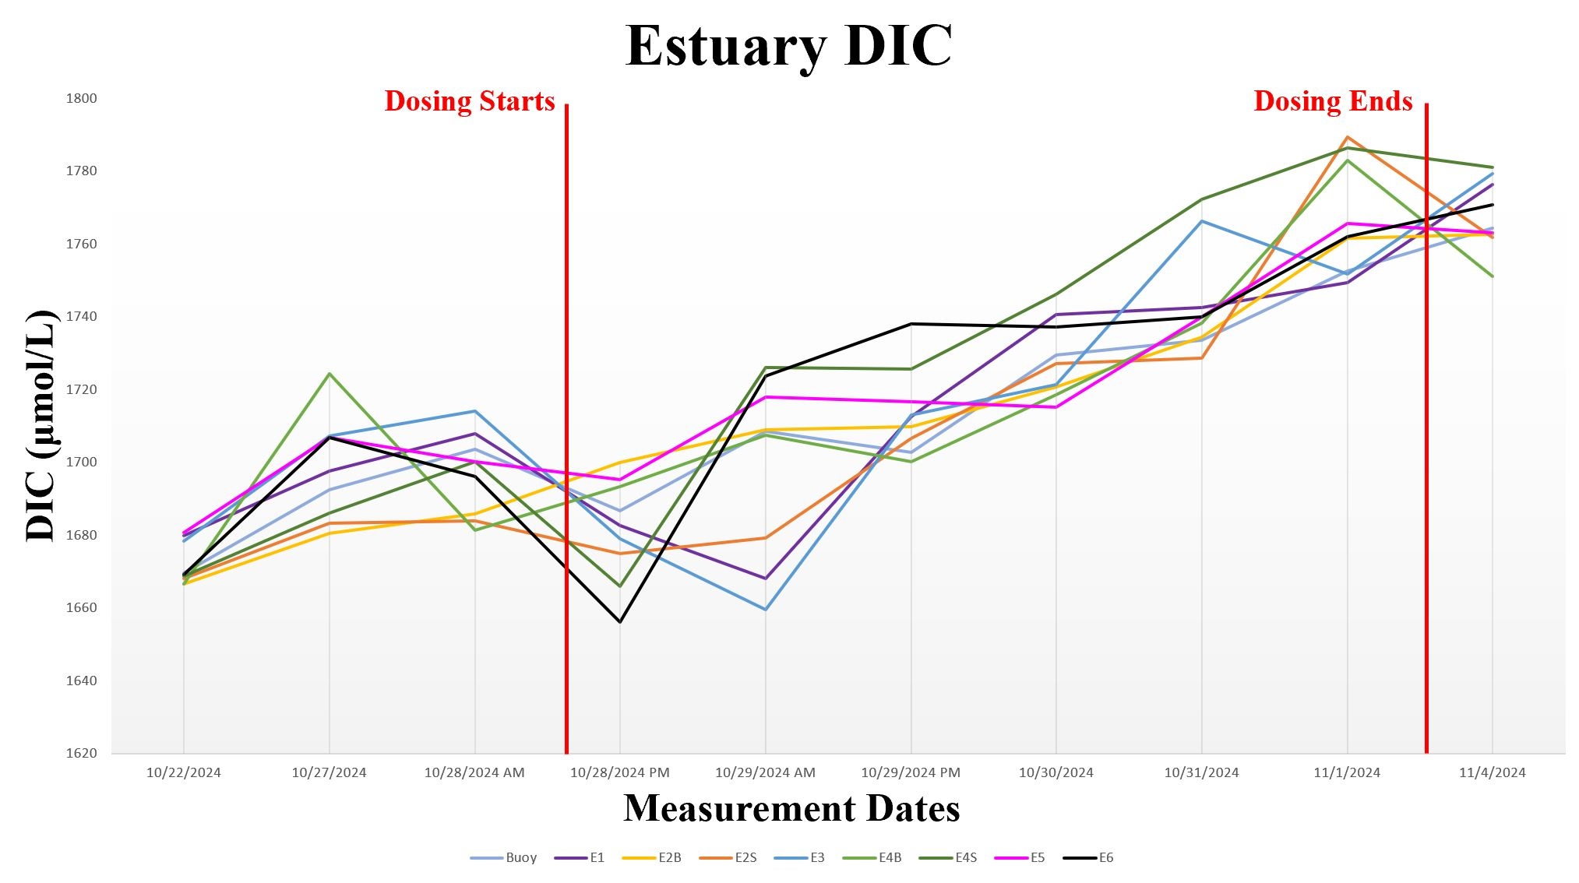
Fall 2024 Trial Estuary DIC

Slide 27
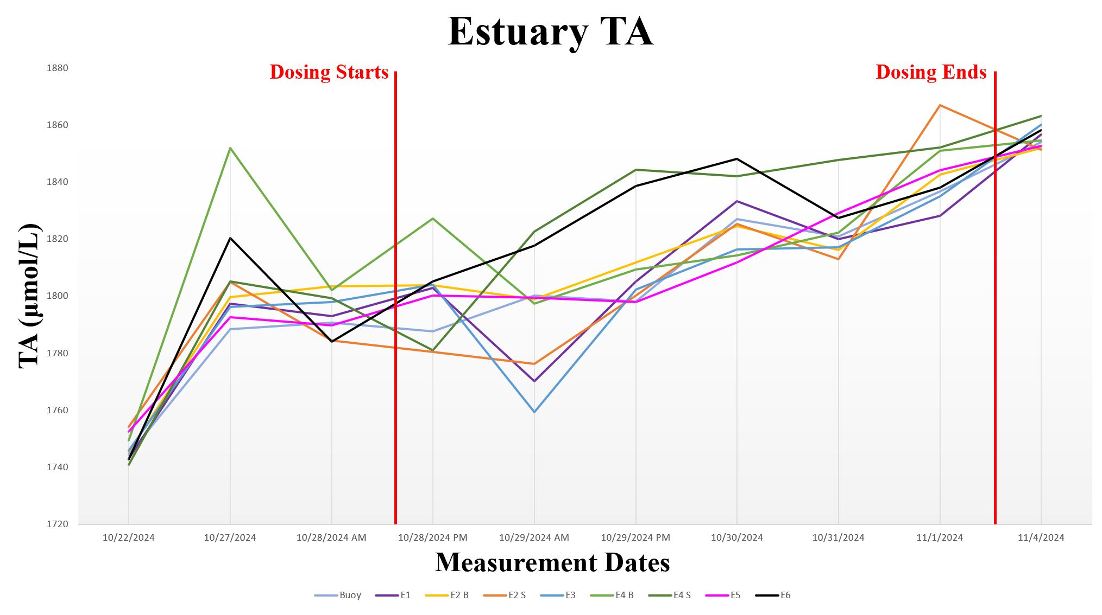
Fall 2024 Trial Estuary TA

Slide 28
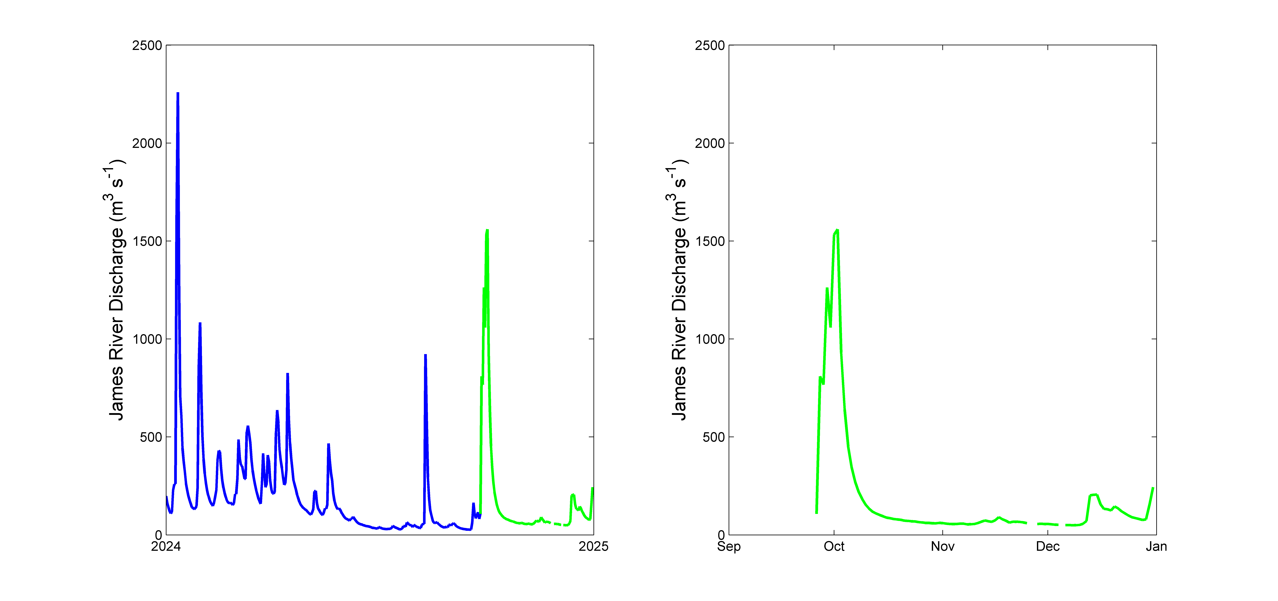
The Messy Estuary Part 1

Slide 29
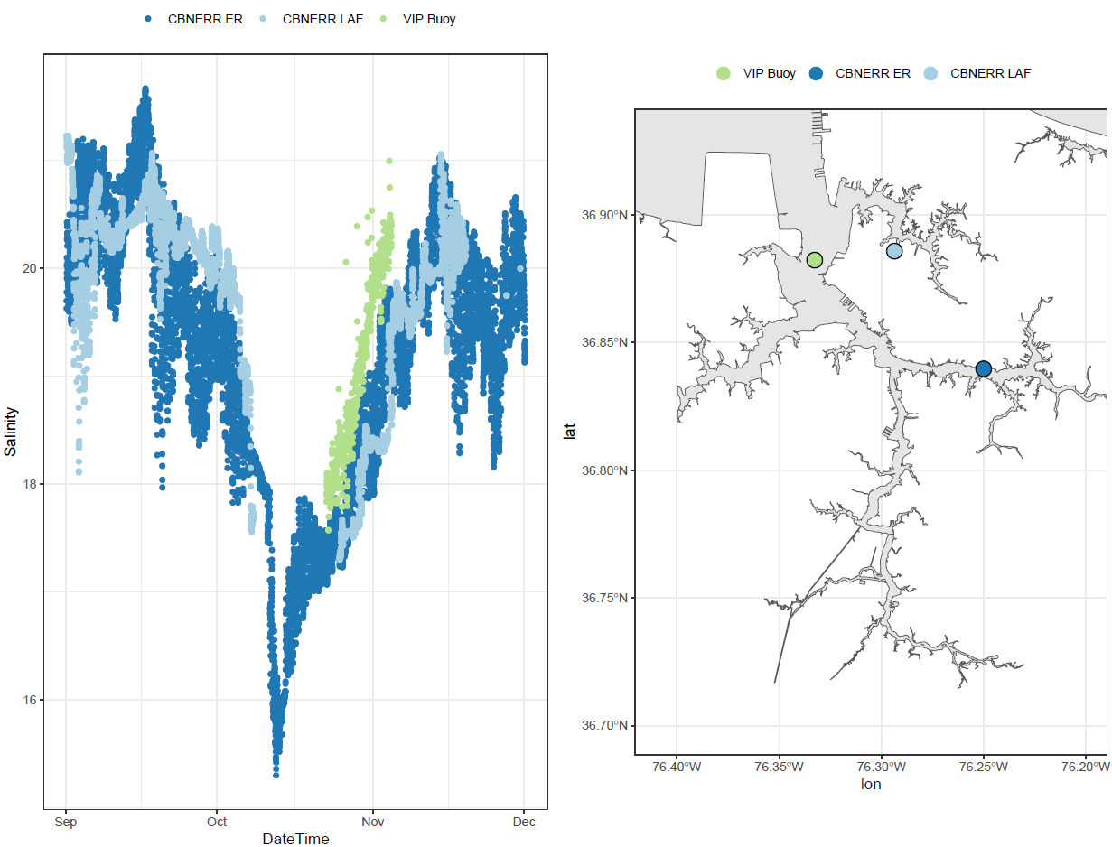

Slide 30
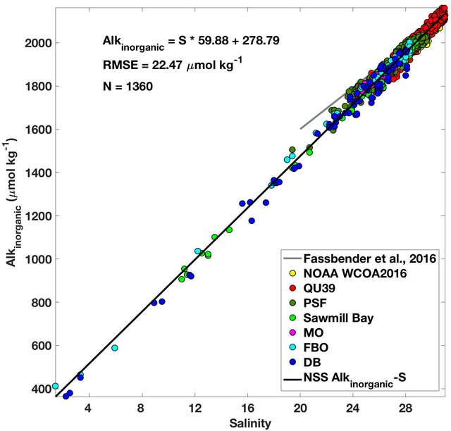
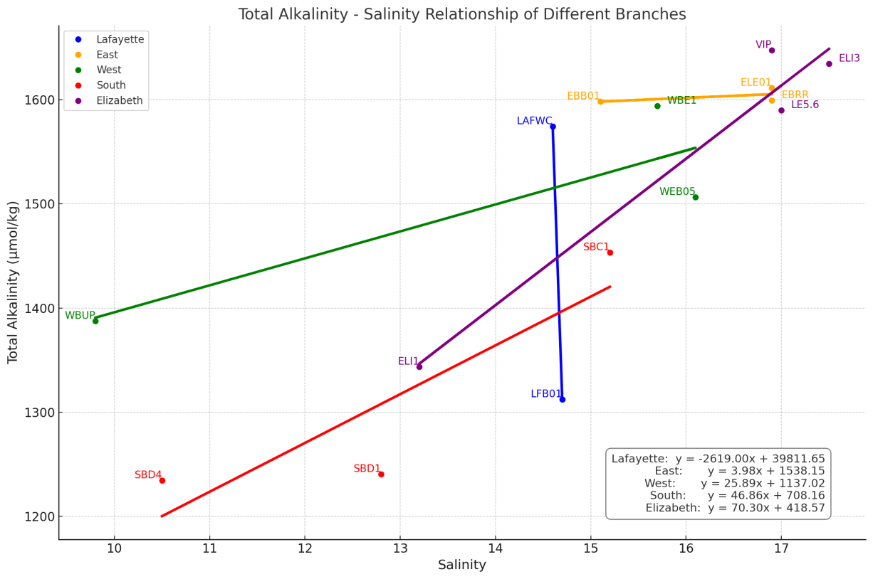
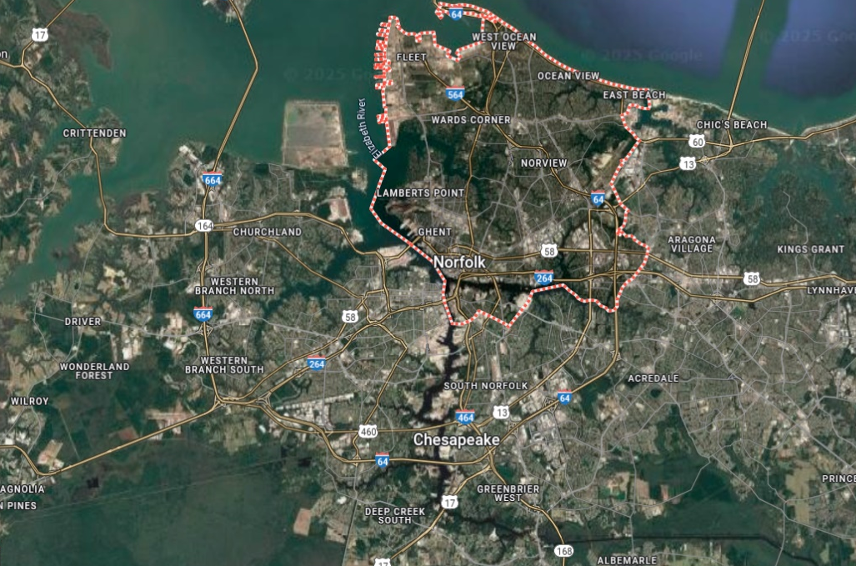
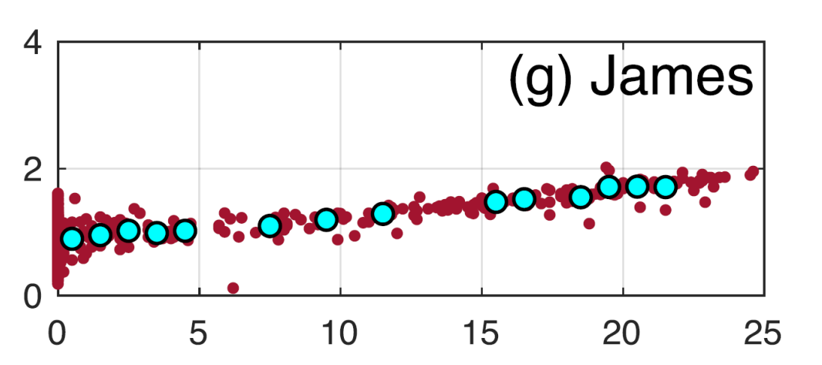
The Messy Estuary Part 2
Evans et al. 2019
Elizabeth River

Slide 31
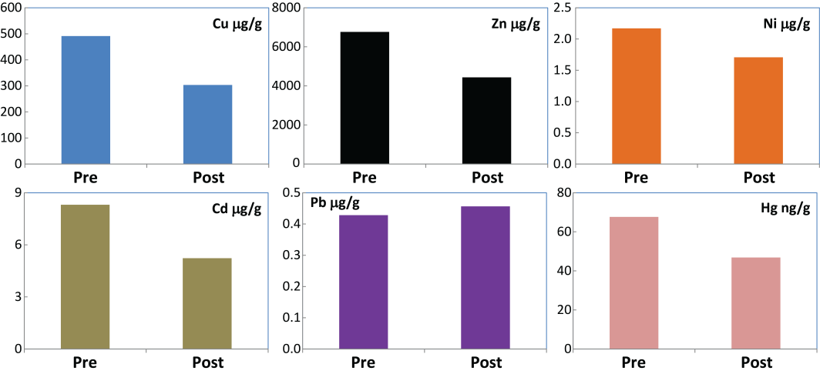
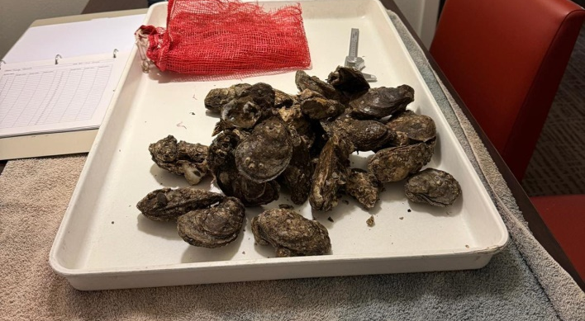
Biological Monitoring

Slide 32
Conclusions
Modeling suggests that the net CO₂ effect of OAE can be bigger by reducing emissions during upstream additions
Downstream OAE successfully increased pH, TA, and DIC in effluent, reduced CO₂
Alkalinity and pH increased in estuary during the trial, but some of this likely due to changes not associated with OAE
No obvious biological impacts of the trials
Next Trial planned for 6 weeks in June and July

Slide 33
Questions?

Slide 34
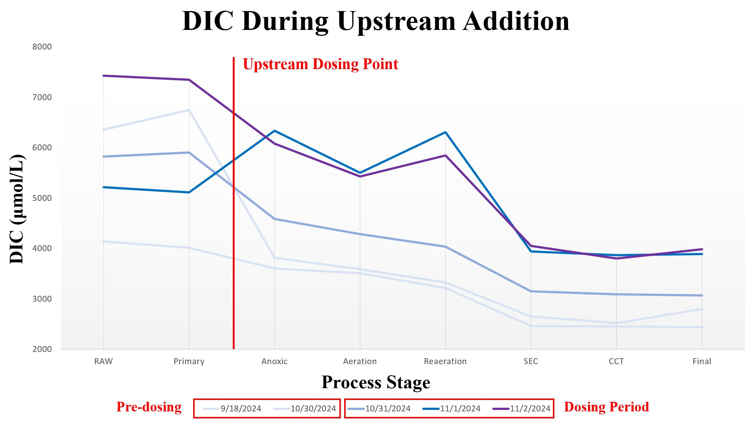

Slide 35
